Slide 1
Bacchus Winery Database Case Study
Module 11 – Milestone #4
CSD 310
Group 3
James Buzzell
Noor Al Salihi
Abram Denzlinger
12/11/2025

Slide 2
Group Introduction
Our team worked together to create and construct a relational database for Bacchus Winery. We worked with making sure that the database enforced business rules and had a clean ERD, and was able to produce reports that were useful for real business decisions.

Slide 3
Case Study Overview
The Bacchus Winery needed a database for suppliers, inventory, customers, employees, and orders. The objective was to organize the data and generate reports that can be used to track sales, manage inventory, and employee performance.

Slide 4
Business Rules Summary
1- One supplier can supply many inventory items
2- Each inventory item has one supplier
3- Orders can include many inventory items
4- Each order is processed by one employee
5- Employees belong to one department
6- Employees may report to a manager
7- Each order has a unique tracking number

Slide 5
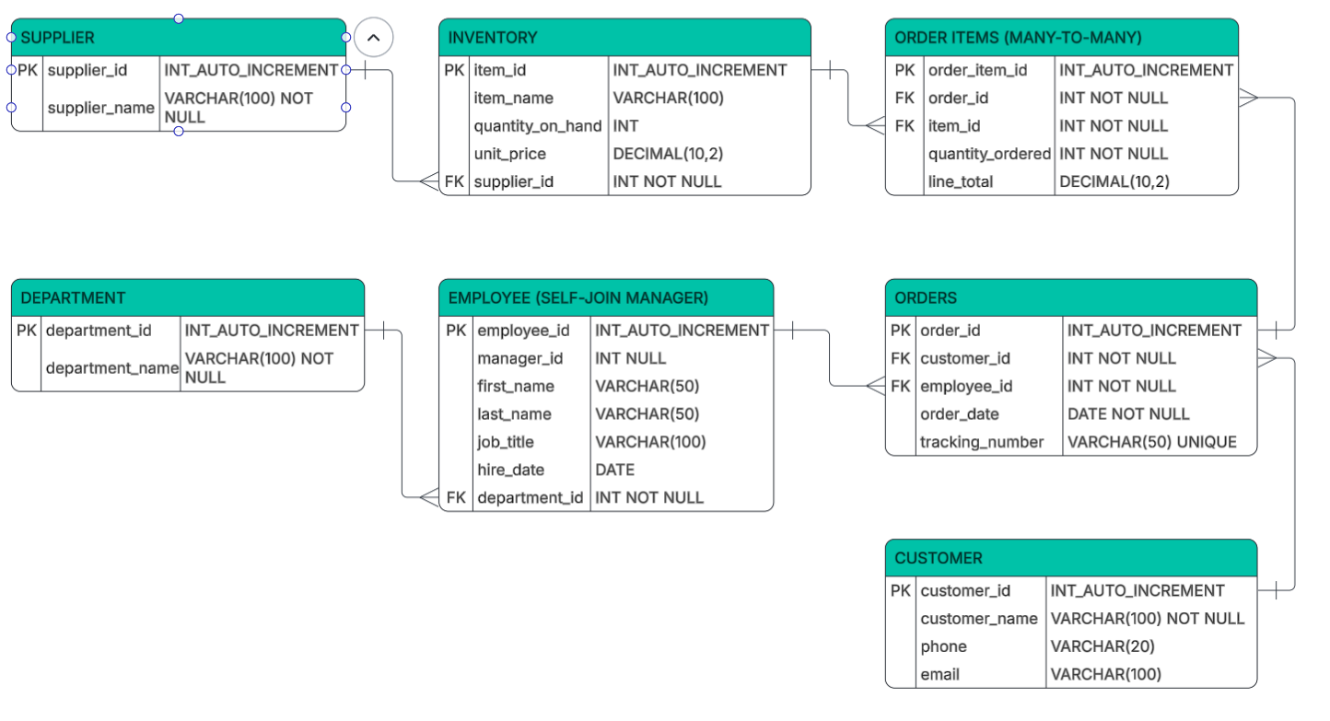
Final ERD
The complete ERD is shown below. The Supplier, Inventory, Customer, Orders, Order Items, Employee, and Department tables are included. Primary and foreign keys have been used to ensure all relationships and business rules are met.

Slide 6
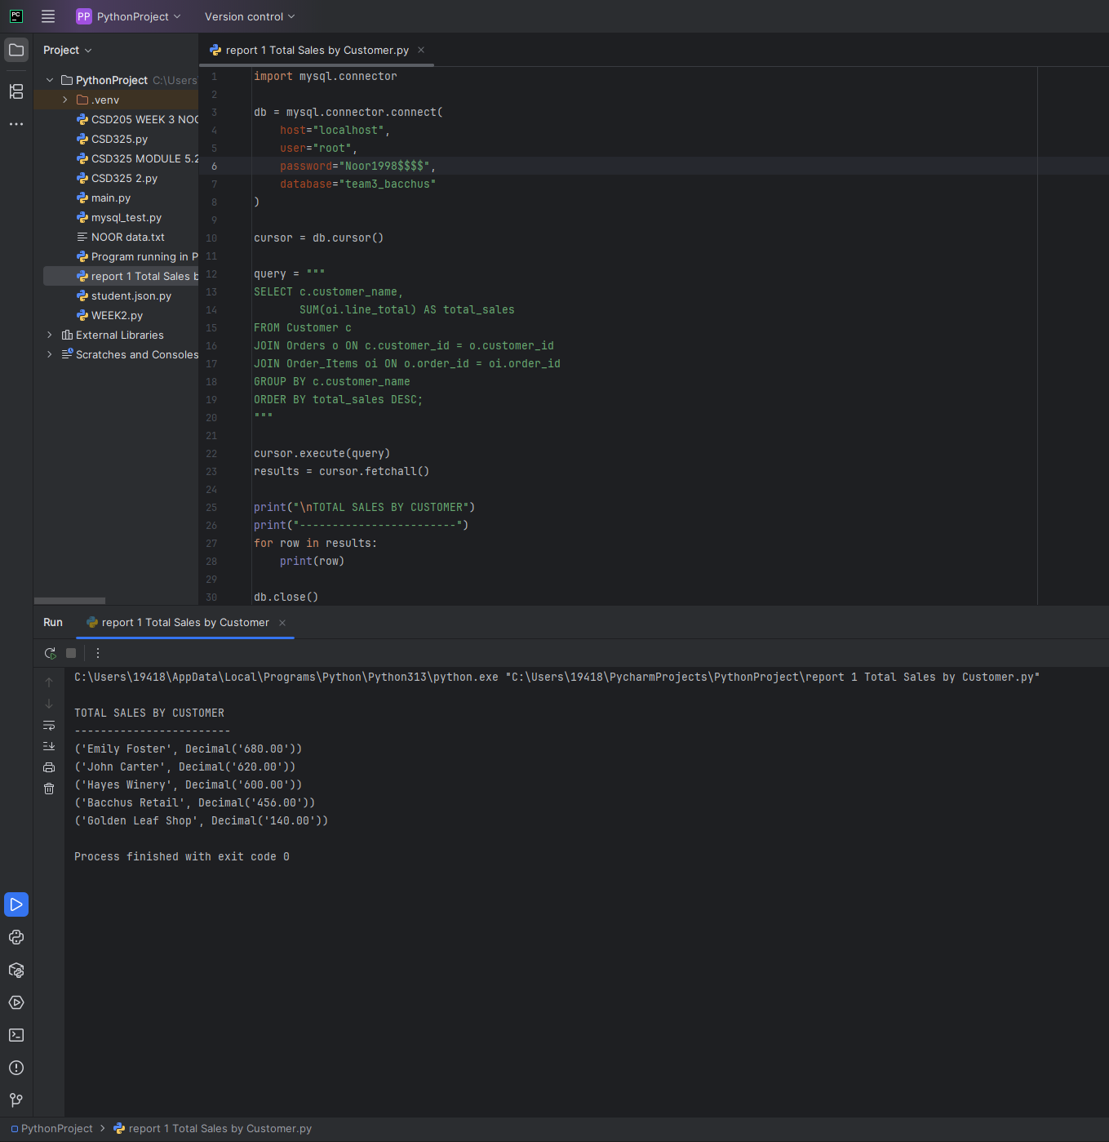
Report 1: Total Sales by Customer
This report calculates total sales per customer.
Why it matters:
Identifies top customers
Supports marketing and distributor decisions

Slide 7
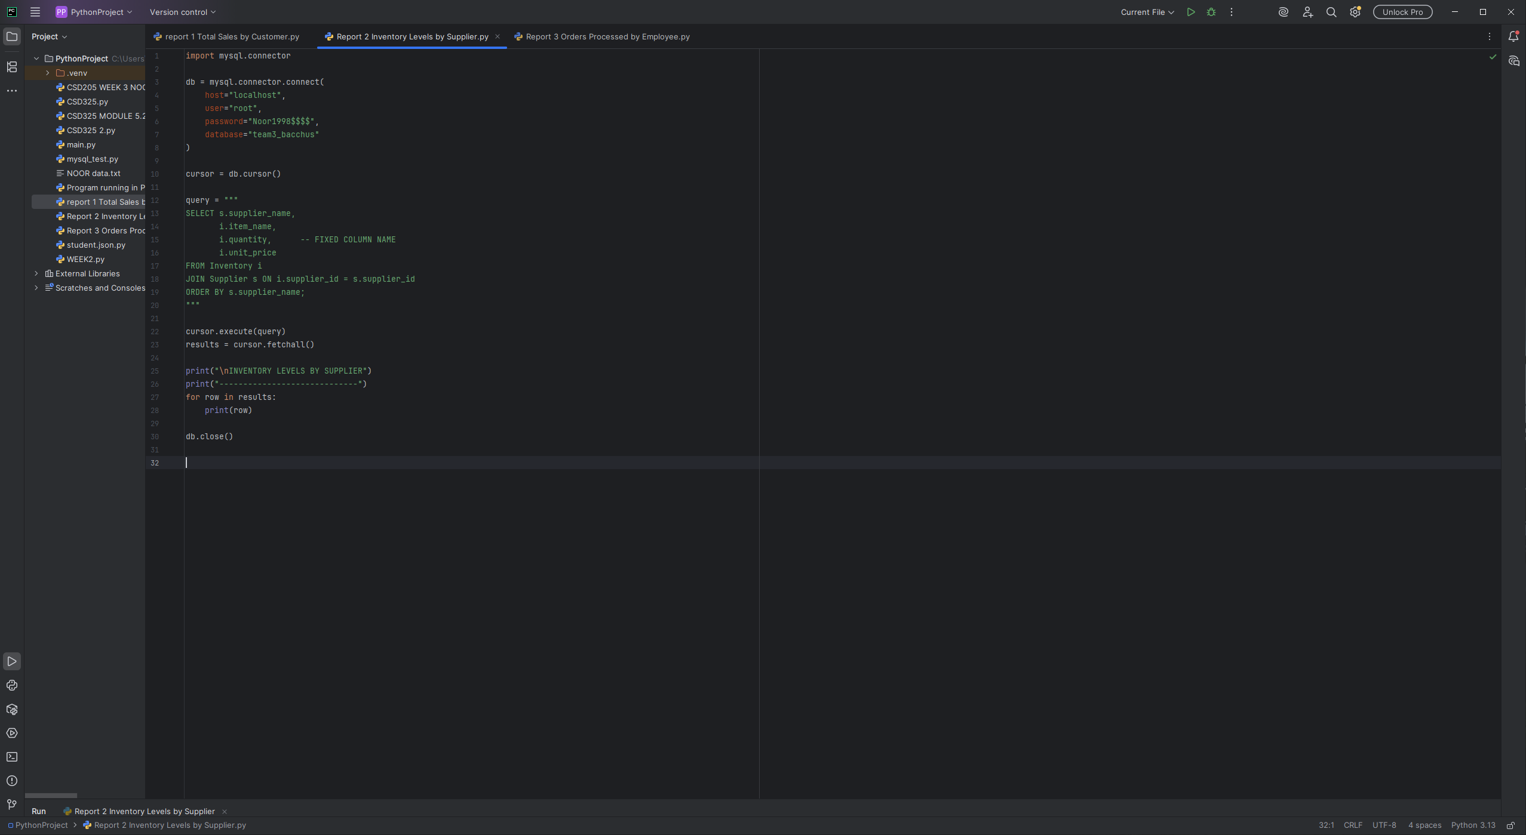
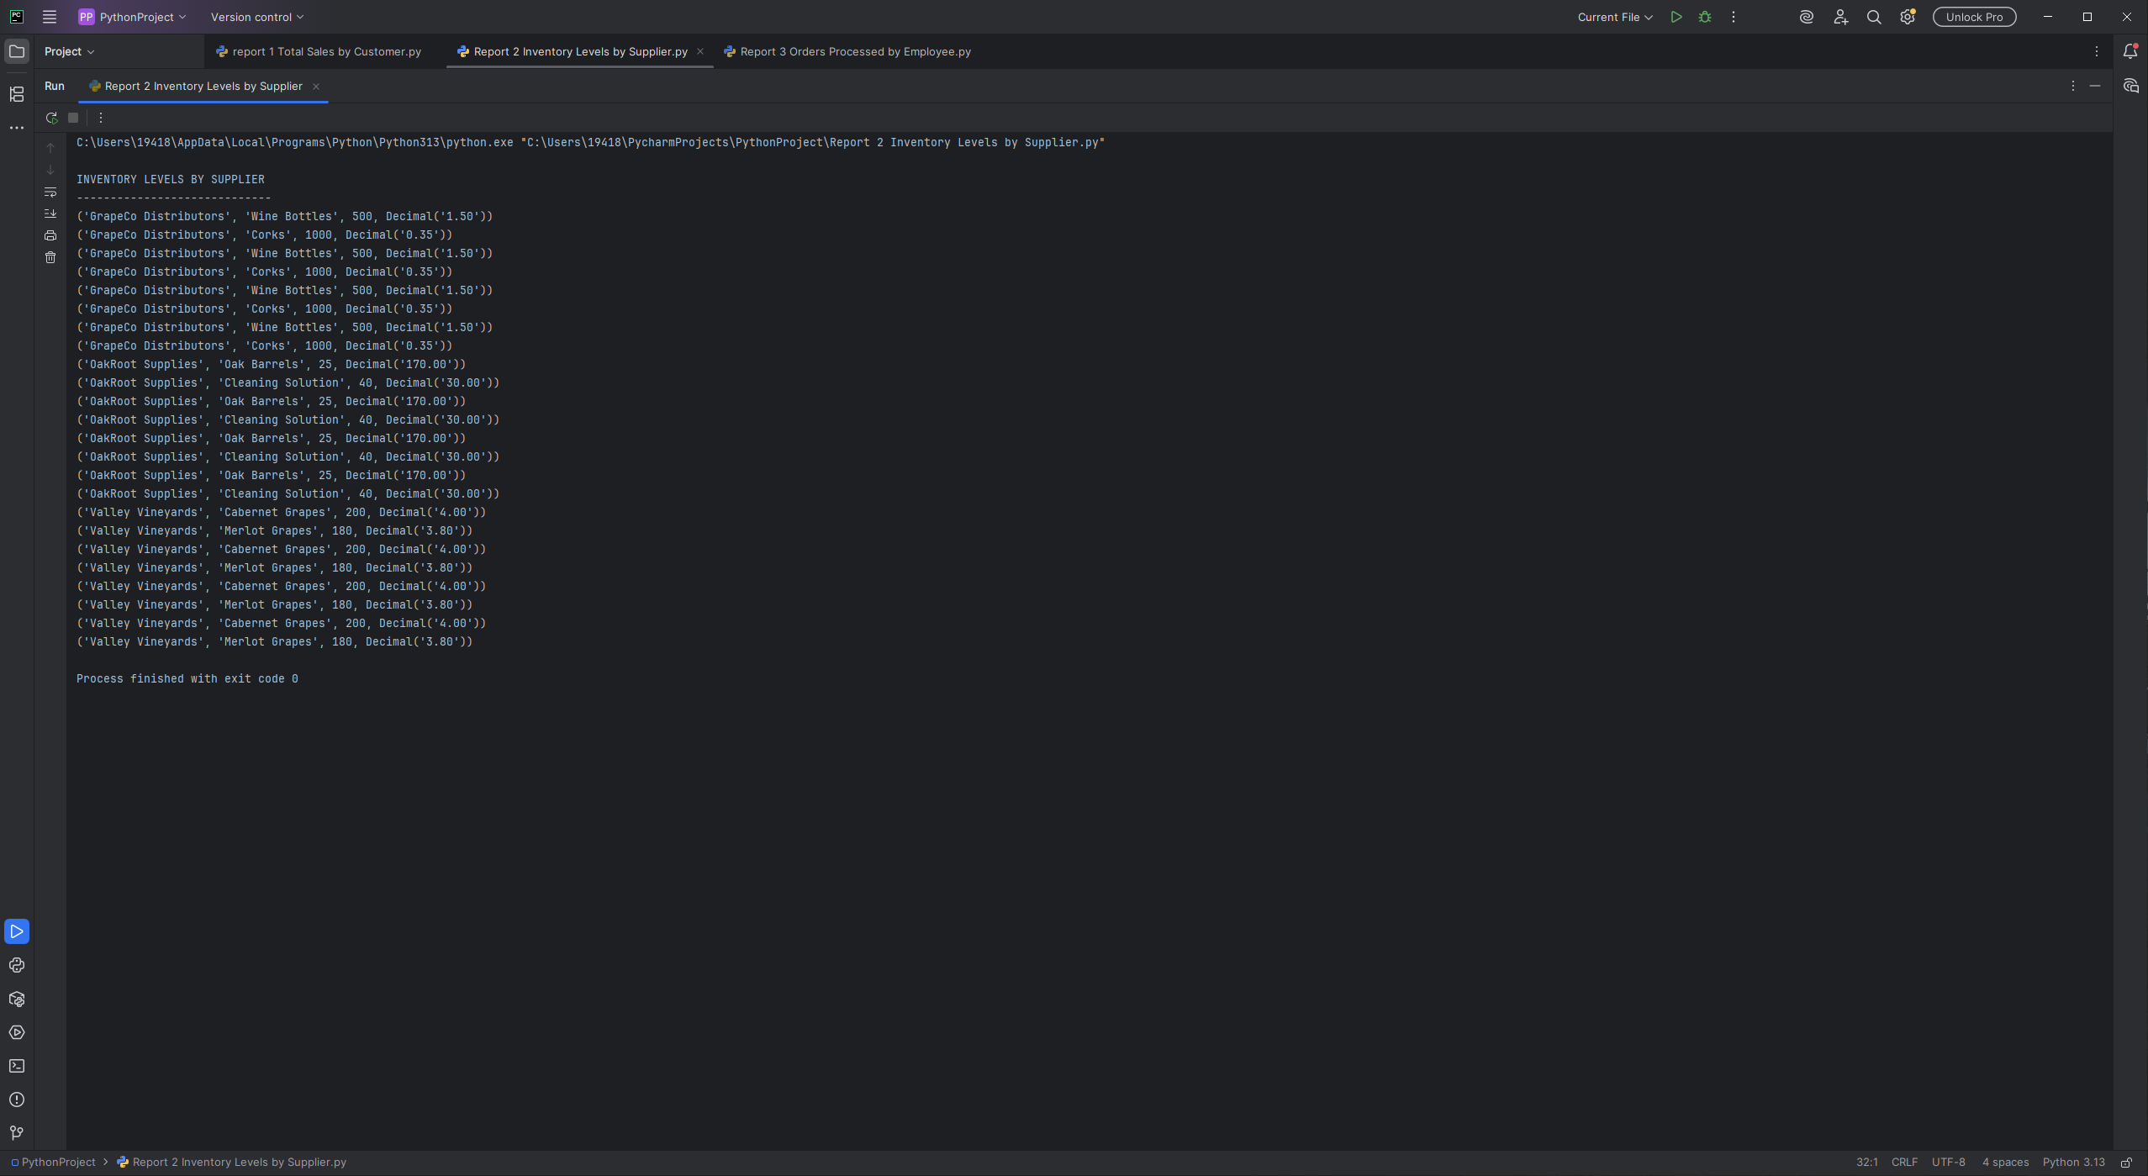
Report 2: Inventory Levels by Supplier
This report lists inventory items grouped by supplier.
Why it matters:
Tracks inventory levels
Supports purchasing decisions

Slide 8
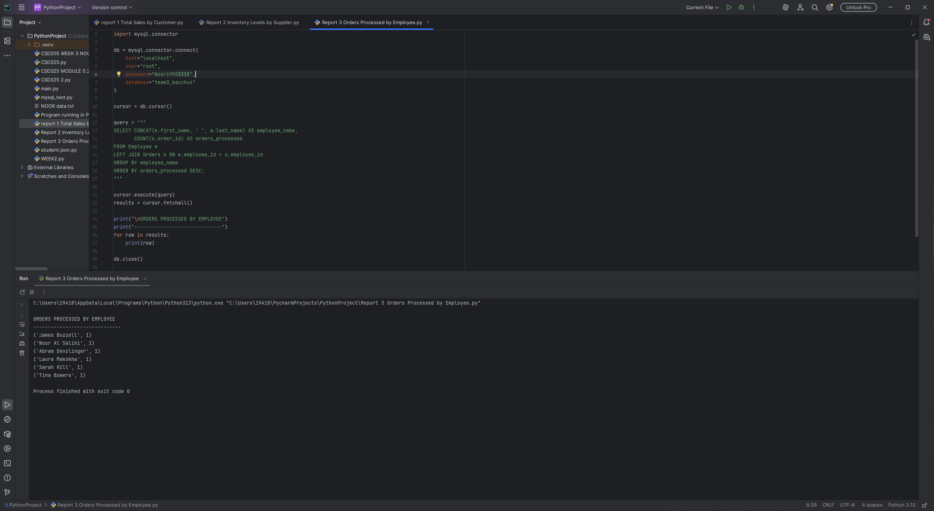
Report 3: Orders Processed by Employee
This report shows how many orders each employee processed.
Why it matters:
Evaluates workload
Helps balance staffing

Slide 9

Assumptions
• Walk-in customer storage - on customer names
• Order to one employee
• Suppliers are material only - not full wine
• Tracking# system generated
• Totals are done on-line totals

Slide 10
Conclusion
Our database design adequately supports the business needs of Bacchus Winery by enforcing the business rules and producing useful reports. The reports can be used to gain important knowledge about sales performance, inventory control, and employee productivity to help make educated business decisions.

